Slide 1

03-Linked List

Slide 2

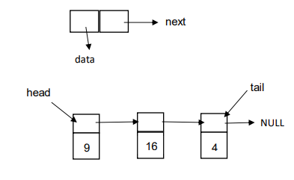
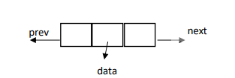
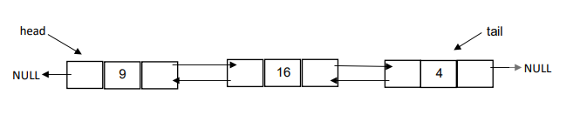
רשימה מקושרת היא מבנה נתונים שבו העצמים ערכיים (איברים) מסודרים בסדר ליניארי.
בניגוד למערך שבו הסדר הליניארי נקבע על ידי אינדקסים, ברשימה מקושרת הסדר נקבע על ידי מצביעים הכוללים בכל אחד מן העצמים.
כל איברים (עצמים) ברשימה מקושרת נמצאים בזיכרון באופן אקראי.
סוגים של רשימה מקושרת:
רשימה מקושרת חד-כיוונית
רשימה מקושרת דו-כיוונית
רשימה מקושרת מעגלית
גם רשימה מקושרת חד-כיוונית וגם רשימה מקושרת דו-כיוונית יכולות להיות מעגליות (איבר הארון מצביע לאיבר הראשון ברשימה מקושרת).

Slide 3
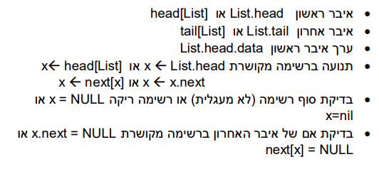

גישה לאיברי רשימה מקושרת (נניח ששם של רשימה List)

Slide 4
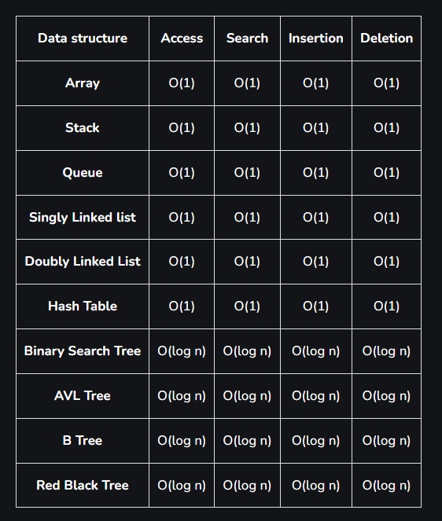
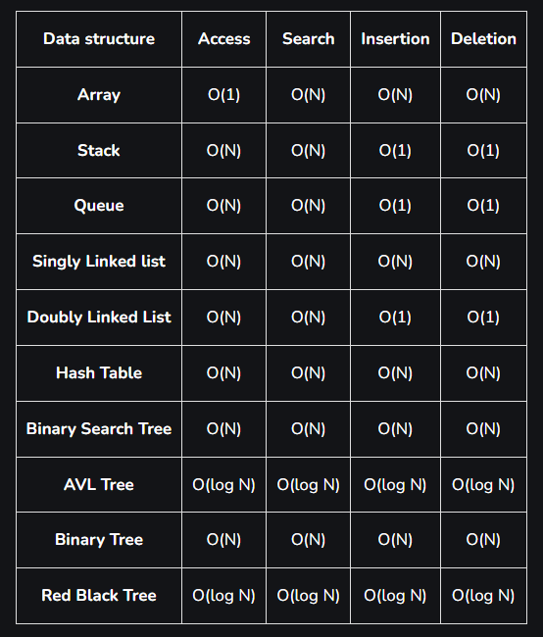
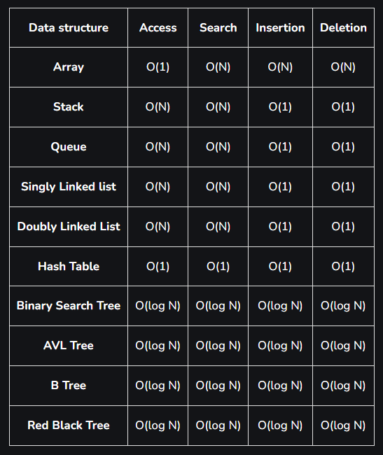
Time complexities of different data structures
Best case time complexity of different data structures for different operations
Worst Case time complexity of different data structures for different operations
The average time complexity of different data structures for different operations

Slide 5
תרגיל 1
כתבו פסאודו-קוד של אלגוריתם המקבל רשימה מקושרת חד-כיוונית ומחזיר סכום מספרים זוגיים.
function sum_of_even_numbers(linkedList):
if linkedList is empty:
return 0
sum = 0
node = linkedList.head
while node is not null:
if node.value is even:
sum = sum + node.value
node = node.next
return sum
Notes:
The time complexity of the algorithm `sumOfEvenNumbers` for a linked list is O(N), where N is the number of nodes in the linked list.
1. **Initialization:**
- The function initializes the `sum` variable to 0 and sets the `node` pointer to the head of the linked list. Both of these operations take constant time, O(1).
2. **Traversing the List:**
- The algorithm uses a `while` loop to iterate through each node in the linked list. In the worst case, it visits each node exactly once, making this part of the algorithm O(N), where N is the number of nodes in the linked list.
3. **Checking and Summing:**
- Within the loop, there is a constant-time operation to check if the value of the current node is even and then add it to the `sum` variable if it is. These operations do not depend on the size of the linked list and are O(1).
4. **Moving to the Next Node:**
- After each iteration, the `node` pointer is moved to the next node in the list. This is a constant-time operation, O(1).
5. **Returning the Result:**
- Finally, the function returns the calculated sum. This is a constant-time operation, O(1).
Therefore, the dominant factor contributing to the time complexity is the traversal of the linked list, which results in an overall time complexity of O(N), where N is the number of nodes in the linked list.

Slide 6
תרגיל 2
כתבו פסאודו-קוד של אלגוריתם תחליף בין איבר ראשון ואחרון ברשימה מקושרת חד-כיוונית.
function swap_first_and_last(L):
x <- L.head
if x != NULL and x.next != NULL then:
temp <- x
while temp.next.next != NULL do
temp = temp.next
last = temp.next
temp.next = x
last.next = x.next
l.head = last
x.next = NULL
Notes:
The time complexity of the `swapFirstAndLast` algorithm for a linked list is O(N), where N is the number of nodes in the linked list.
1. **Base Case Check:**
- The function checks if the linked list is empty or has only one node. This is a constant-time operation, O(1).
2. **Finding the Last Node:**
- The algorithm uses a `while` loop to traverse the linked list and find the last node. In the worst case, it visits each node once, making this part of the algorithm O(N), where N is the number of nodes in the linked list.
3. **Swapping Values:**
- After finding the last node, the algorithm swaps the values of the first and last nodes. This is a constant-time operation, O(1).
4. **Returning the Result:**
- Finally, the function returns the modified linked list. This is a constant-time operation, O(1).
The dominant factor contributing to the time complexity is the traversal of the linked list, resulting in an overall time complexity of O(N), where N is the number of nodes in the linked list.

Slide 7
תרגיל 3
כתבו פסאודו-קוד של אלגוריתם שמוסיף צומת חדש לרשימה מקושרת ממוינת תוך שמירה על הסדר הממוין של הרשימה.
function try(L, N):
# L is a sorted Linked List
# N is a Linked List with one node
if L.head is NULL:
L.head ← N.head
else:
if N.head.data < L.head.data:
N.head.next ← L.head
L.head ← N.head
else:
x ← L.head
while x.next is not NULL and N.head.data ≥ x.next.data:
x ← x.next
N.head.next ← x.next
x.next ← N.head
return L
This algorithm should properly merge a sorted linked list L with a linked list N that has only one node.
Notes:
The time complexity of the `try` algorithm depends on the size of the sorted linked list `L` and the position where the node from `N` is inserted into `L`. Let's analyze each part:
1. **Base Case Check:**
- Checking if `L.head` is NULL is a constant-time operation, O(1).
2. **Insertion at the Beginning of `L`:**
- If `L.head` is NULL, the algorithm inserts the node from `N` at the beginning of `L`. This is a constant-time operation, O(1).
3. **Insertion at a Position Other Than the Beginning:**
- If `L.head` is not NULL, the algorithm checks whether the node from `N` should be inserted before the current head of `L` based on the comparison of data values.
- If insertion is at the beginning, it is a constant-time operation, O(1).
- Otherwise, the algorithm uses a `while` loop to traverse `L` to find the correct position for insertion. In the worst case, it may need to traverse the entire list, resulting in a time complexity of O(N), where N is the number of nodes in `L`.
Overall, the time complexity of the `try` algorithm is O(N) in the worst case, where N is the number of nodes in the sorted linked list `L`. If the insertion happens at the beginning (when `L.head` is NULL) or is at a position other than the beginning, it is O(1).

Slide 8
תרגיל 4
כתבן פסאודו-קוד של אלגוריתם הממיין רשימה מקושרת חד-כיוונית.
function sort_linked_list(L):
# L is linked list
# L_{new} is new linked list
# L_{temp} is temp linked list
while L.head != NULL do:
L_{temp}.head <- L.head
L.head <- L.head.next
try(L_{new}, L_{temp}) # function from task 3
return L_{new}
Notes:
The time complexity of the Bubble Sort algorithm applied to a linked list is O(N^2), where N is the number of nodes in the linked list. Here's the breakdown of the time complexity:
Outer Loop (Traversing the List):
The outer loop of the Bubble Sort algorithm iterates N times, where N is the number of nodes in the linked list. In each iteration, the algorithm compares and possibly swaps adjacent elements.
The worst-case scenario is when the list is in reverse order, and the algorithm needs to perform N iterations for each element to move it to its correct position.
Therefore, the time complexity of the outer loop is O(N).
Inner Loop (Comparisons and Swaps):
The inner loop compares and swaps adjacent elements. In the worst case, the inner loop iterates N times for each outer loop iteration.
The total number of comparisons and swaps in the inner loop is proportional to N^2.
Therefore, the time complexity of the inner loop is O(N^2).
Overall Time Complexity:
Combining the time complexities of the outer and inner loops, the overall time complexity of the Bubble Sort algorithm for a linked list is O(N) * O(N^2) = O(N^2).
Bubble Sort is not the most efficient sorting algorithm, especially for large datasets, but it is straightforward to implement. Other sorting algorithms like Merge Sort or Quick Sort may offer better performance for large datasets.
Merge Sort algorithm adapted for a linked list. Run time: O(n log n)
function mergeSortLinkedList(head):
if head is NULL or head.next is NULL:
return head // Base case: empty or single-node list
// Split the linked list into two halves
middle = findMiddle(head)
leftList = head
rightList = middle.next
middle.next = NULL // Splitting the list
// Recursively sort both halves
leftList = mergeSortLinkedList(leftList)
rightList = mergeSortLinkedList(rightList)
// Merge the sorted halves
sortedList = merge(leftList, rightList)
return sortedList
function findMiddle(head):
slowPointer = head
fastPointer = head.next
while fastPointer is not NULL and fastPointer.next is not NULL:
slowPointer = slowPointer.next
fastPointer = fastPointer.next.next
return slowPointer
function merge(left, right):
mergedList = NULL
tail = NULL
while left is not NULL and right is not NULL:
if left.data <= right.data:
if mergedList is NULL:
mergedList = tail = left
else:
tail.next = left
tail = left
left = left.next
else:
if mergedList is NULL:
mergedList = tail = right
else:
tail.next = right
tail = right
right = right.next
// Append remaining elements from both lists
if left is not NULL:
tail.next = left
else:
tail.next = right
return mergedList

Slide 9
תרגיל 5
כתבו פסאודו-קוד של אלגוריתם המקבל רשימה מקושרת חד-כיוונית מעגלית ומוסיף איבר נוסף ל"סוף" רשימה (לפני איבר שמצביע לראש רשימה).
function add_at_end_circular_linked_list(list, value):
newNode = createNode(value)
if list.head is NULL:
list.head = newNode
newNode.next = newNode
else:
current = list.head
while current.next is not list.head:
  current = current.next
  current.next = newNode
  newNode.next = list.head
Notes:
The time complexity of the addAtEndCircularLinkedList algorithm depends on the number of nodes in the circular linked list. Let's analyze the time complexity step by step:
Base Case Check:
The initial check for whether the list is empty is a constant-time operation, O(1).
Creating a New Node:
Creating a new node using createNode(value) is a constant-time operation, O(1).
Inserting at the End:
If the list is not empty, the algorithm traverses the circular list to find the node before the head.
In the worst case, the traversal requires visiting each node once. Therefore, the traversal has a time complexity of O(N), where N is the number of nodes in the circular linked list.
Inserting the New Node:
After finding the node before the head, the algorithm inserts the new node at the end. This is a constant-time operation, O(1).
The dominant factor in the time complexity is the traversal of the circular list, resulting in an overall time complexity of O(N), where N is the number of nodes in the circular linked list. If the list is empty, the time complexity is O(1).

Slide 10
תרגיל 6
נתון אלגוריתם. איזה ערך הוא מחזיר?
function try(L):
// L is a bidirectional linked list
flag <- true
x.left <- x.right <- L.head
if L.head ≠ NULL AND L.head.next ≠ NULL then
while x.right.next ≠ NULL do
x.right <- x.right.next
while x.right ≠ x.left and x.left.next ≠ x.right and flag do:
if x.right.data ≠ x.left.data then
flag <- false
x.left <- x.left.next
x.right <- x.right.prev
return flag

Slide 11

תרגיל 7 מועד א׳ 1.05.24
נתונה רשימה מקושרת חד-כיוונית על ידי מצביע לראש הרשימה. אין מצביע לזנב. כתבו אלגוריתם שבודק אם הרשימה מכילה מעגל (כלומר, הצומת האחרון מצביע לאחד הצמתים הקודמים ברשימה).
פתרון צריך להכיל הסבר מילולי מפורט . אפשר לשלב פסאודו-קוד.
זמן ריצה הדרוש הינו O(n), כאשר n הוא מספר האיברים ברשימה. יש לנמק למה הפתרון שהצעתם עומד בדרישות הזמן שבשאלה.
מותר להשתמש רק ב-O(1) זיכרון בנוסף לקלט.
על הפתרון לבצע את הבדיקה מבלי לשנות את הרשימה.

Slide 12
תרגיל 7 פתרון מועד א׳ 1.05.24
ניתן להשתמש באלגוריתם שמשתמש בשני מצביעים, כאשר הם מתקדמים בקצבים שונים על הרשימה. אחד מתקדם בקצב של צעד אחד בכל פעם, ואחד שמתקדם בקצב של שני צעדים בכל פעם. בכל צעד, נבדוק האם המצביע שמתקדם בקצב של שני צעדים הגיע לסוף הרשימה (null). אם כן, זה אומר שאין מעגל ברשימה. אם המצביעים נפגשו, זה אומר שיש מעגל.
function Has_cycle(head):
if head is NULL:
return False
slow_pointer = head
fast_pointer = head.next
while (fast_pointer is not NULL and fast_pointer.next is not NULL)
slow_pointer = slow_pointer.next
fast_pointer = fast_pointer.next.next
if slow_pointer == fast_pointer:
return True return flag

Slide 13


